Slide 1
Project Meeting Presentation

Slide 2
Project Objectives
Examine the alignments of prices within options markets and prediction markets.
Examine the accuracy of prediction markets and how they well they can be trusted.

Slide 3
Equipment and Tools
Python
Numpy, Scipy, PMXT, Yfinance, Pandas
Jupyter Lab

Slide 4
Literature
D. T. Breeden and R. H. Litzenberger, ‘Prices of State-Contingent Claims Implicit in Option Prices’, The Journal of Business, vol. 51, no. 4, pp. 621–651, 1978.
  Provides a formula for determining the the risk-neutral probability density of the stock from its options prices.
  Very simple and fast to implement.

Slide 5
Problems
Very low volume in prediction markets of interest (often under $5000)
Prediction windows are fairly wide (2.5% of current stock price in the case of MSFT)
Multiple different kinds of predictions for one asset (price over x, price within range, European/Asian style)

Slide 6
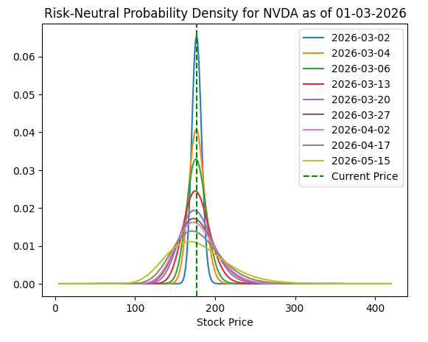
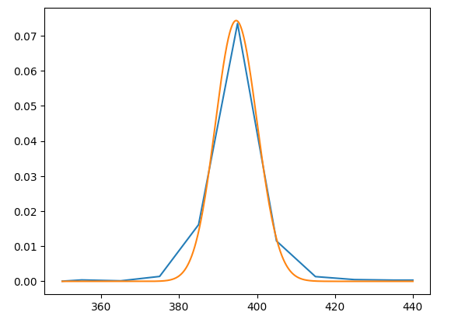
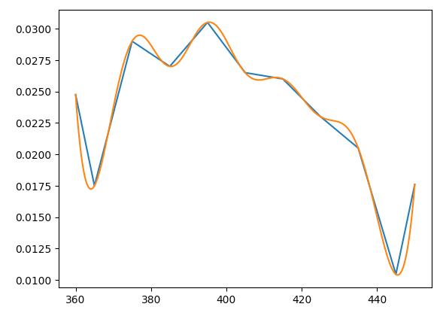
Progress
Chart showing predictions for MSFT price EOW beginning Feb 23 on Feb 27
Chart showing predictions for MSFT price EOW beginning Mar 2 on Mar 1

Slide 7
Next Steps
Find existing research into accuracy of low-volume prediction markets.
Look into other market types for more trade volume to obtain better data.
Look into prediction markets for non-financial topics.

